Slide 1
👏

Slide 2
🙌

Slide 3
Let’s start with a story………..

Slide 4




Slide 5




Slide 6
……..

Slide 7
……..

Slide 8
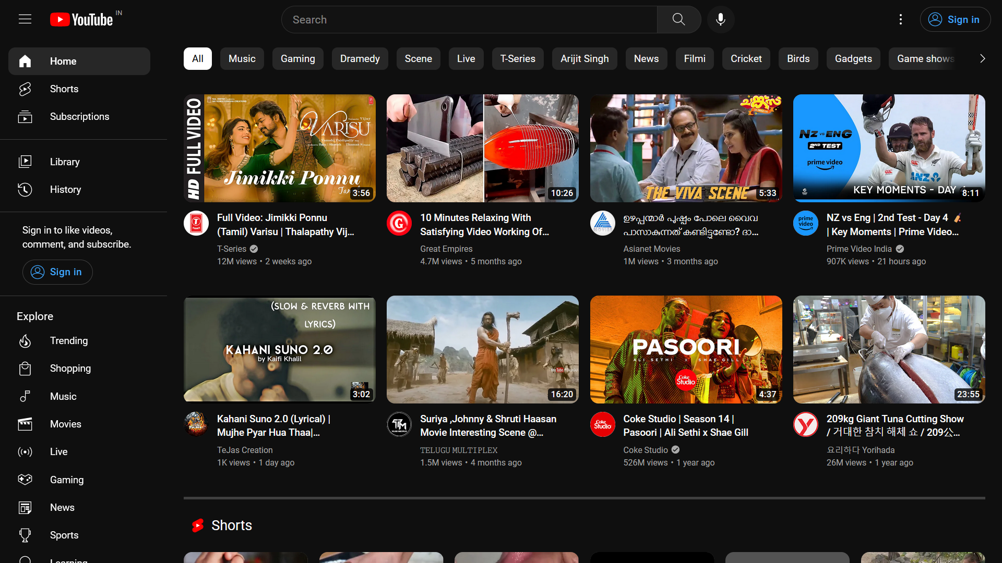
DISTRACTIONS…..!!!!!

Slide 9

#AD
#AD
#AD
#AD
#AD
#AD
#AD
#AD
#AD
#AD

Slide 10
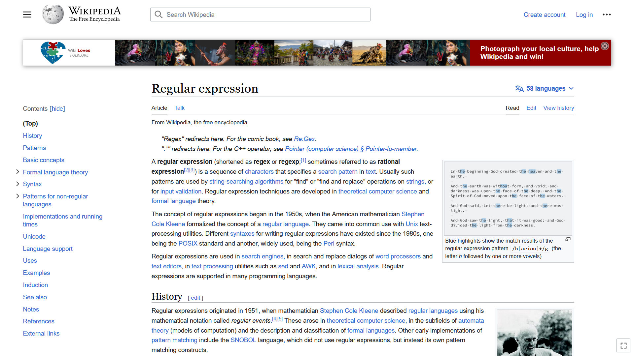
OVERLOAD…!!

Slide 11
Not Getting What I wanted with EASE…!!

Slide 12
……..

Slide 13
……..

Slide 14








Slide 15
We couldn’t ORGANIZE it very WELL

Slide 16
……..

Slide 17
……..

Slide 18




Slide 19
Couldn’t strike into the market

Slide 20
Don’t worry dears
I AM HERE

Slide 21
Oops…!! Forgot…

Slide 22

WHY FEAR
WHEN
I AM
HERE

Slide 23
Jst kidding..

Slide 24
…….

Slide 25

EDUPEDIA
The learning space
Educational Purpose
100k+ Resources
AD FREE

Slide 26
Wait…. NO ADS
What about me then

Slide 27
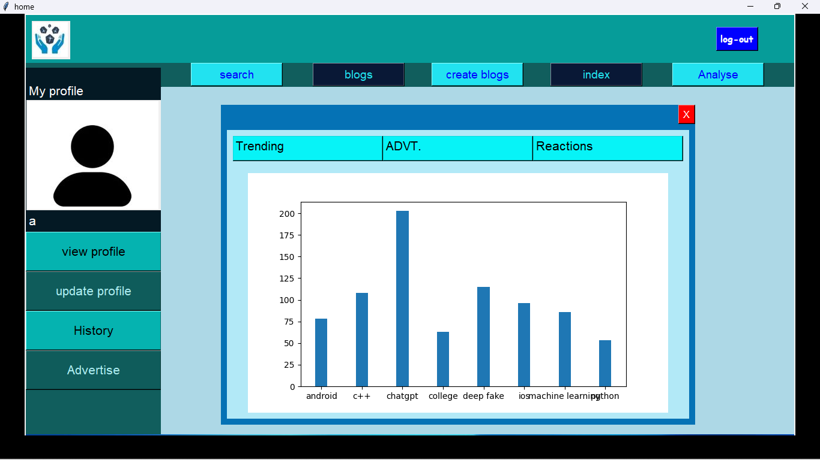

Slide 28
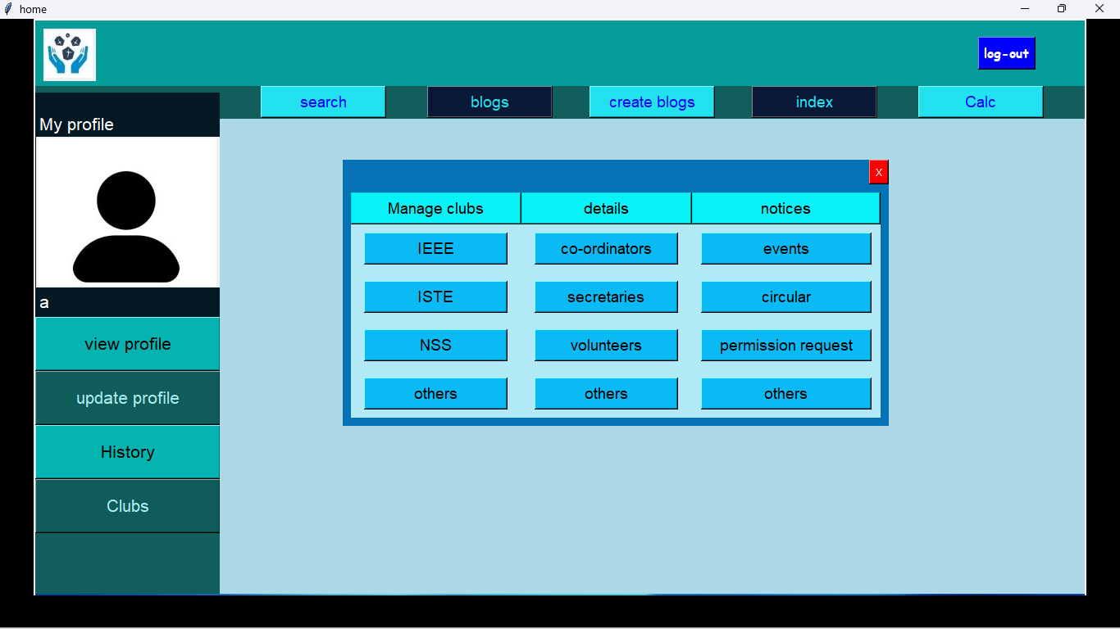

Slide 29
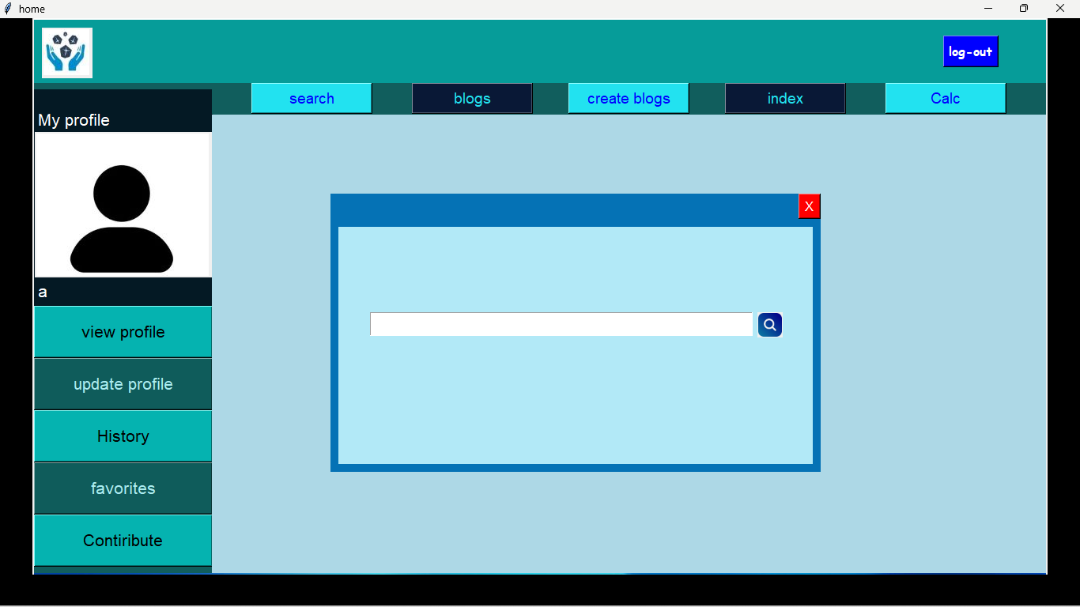

Slide 30
Let’s Get into Edupedia

